Slide 1

Know Before You Send
Explainable blockchain risk intelligence before crypto moves.
V1.0, R3 — Live Production Platform
Live Platform: https://cryptodetective.app

Slide 2

THE PROBLEM
Crypto Transactions Are Irreversible
WHY USERS ARE EXPOSED
THE BLIND SEND
01
A valid address does not mean a safe destination
Risk can remain invisible until after the transaction.
02
Scams and malicious activity can look legitimate
03
Blockchain risk is difficult for everyday users to evaluate
04
Once funds are sent, transactions generally cannot be reversed
Risk intelligence matters most before the transaction.
Crypto Detective is designed to move risk intelligence earlier — to the point of decision.

Slide 3
MARKET REALITY
The Problem Isn’t Crypto — It’s the Blind Send
$17B
2025
$11B+
2025
GLOBAL LOSSES
U.S. LOSSES
Estimated crypto scam & fraud losses
Reported cryptocurrency-related losses
181,565
2025
158K
2025
FBI COMPLAINTS
WALLET COMPROMISES
Cryptocurrency-related complaints reported to the FBI
Personal wallet compromise incidents identified
Crypto needs intelligence at the point of decision.

Slide 4
THE SOLUTION
Crypto Detective Adds Intelligence Before You Send
WHAT CRYPTO DETECTIVE ADDS
FROM INPUT TO INFORMED DECISION
01
Blockchain & transaction intelligence
WALLET / CONTRACT / URL
INVESTIGATE
RISK
INTELLIGENCE
INFORMED DECISION
02
Entity & protocol recognition
→
→
→
INPUT
ANALYZE
SCORE
ACT
03
Scam, phishing & threat intelligence
04
Explainable 0–100 risk scoring
Multiple intelligence layers are translated into a clear risk result before crypto moves.
From raw blockchain data to an informed decision — before crypto moves.

Slide 5
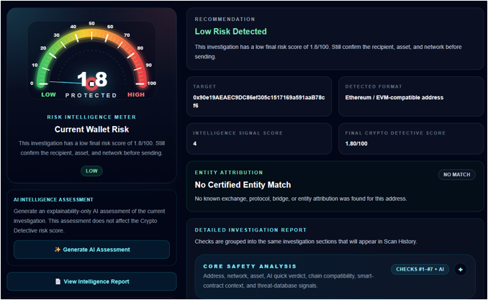
HOW IT WORKS
Multiple Intelligence Layers. One Explainable Result.
THE INVESTIGATION PIPELINE
LIVE PRODUCT — V1.0, R3
1
INVESTIGATE
Wallet • Contract • URL
2
ANALYZE
Matrix V3 • Intelligence Library • Threat Intelligence
3
SCORE
Final Crypto Detective Score • 0–100
4
EXPLAIN
Risk Level • Signals • Reasons • Next Steps
Not just a score. The intelligence behind the score.

Slide 6
FROM CONCEPT TO LIVE PRODUCTION
Production Platform, REST API & SDK Built and Tested.
LIVE NOW
Crypto Detective V1.0, R3 — Production Platform
✓
LIVE PLATFORM
✓
MATRIX V3
✓
INTELLIGENCE LIBRARY
V1.0, R3 production platform
Multi-signal scoring architecture
Structured entity & protocol intelligence
✓
THREAT INTELLIGENCE
✓
REST API + SDK
✓
MARKETPLACE INTEGRATION
Scam, phishing & malicious-activity checks
Production REST API; SDK on npm
NFT Trading Cards buyer protection
WHAT THE ROUND FUNDS
Customer acquisition • Enterprise outreach • Intelligence growth • Scale
The raise is not to build the product. It is to grow the platform.

Slide 7

FOUNDER
Stephen Steinberger
Founder & CTO | Crypto Detective Labs, Inc.
FOUNDER EXPERIENCE
FOUNDER-LED EXECUTION
30+ YEARS
Building internet platforms and digital products
WEB3 BUILDER
Founder of NFT-TradingCards.biz and the nftXc ecosystem
DIGITAL ASSETS
Experience across marketplaces, blockchain infrastructure and digital assets
PRODUCT EXECUTION
Architect and developer of Crypto Detective V1.0, R3 — concept to production
Founder-led. Built from concept to production.

Slide 8
MARKET OPPORTUNITY
Digital Assets Are Growing. Security Must Grow With Them.
774M
$7.6B
$31.3B
GLOBAL CRYPTO OWNERS
BLOCKCHAIN SECURITY
PROJECTED MARKET
Estimated as of June 2026
Estimated global market in 2026
Global blockchain security market by 2033
22.4% CAGR
Projected 2026–2033 blockchain security market growth
CONSUMERS • PLATFORMS • ENTERPRISE
As digital assets grow, risk intelligence becomes infrastructure.

Slide 9
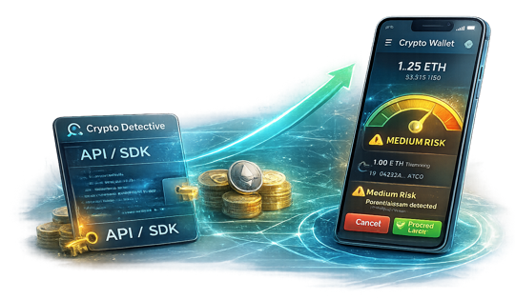
BUSINESS MODEL
One Intelligence Platform. Multiple Revenue Channels.
REVENUE CHANNELS
PLATFORM EXPANSION VISION
01
CONSUMER SaaS
Recurring subscriptions
Free → Paid plans
02
API / SDK
REST API + published npm SDK
Monthly API subscription tiers
03
ENTERPRISE
Investigation & intelligence access
Custom high-volume engagements
SaaS → API / SDK → Enterprise
Build the intelligence once. Deliver it across multiple channels.

Slide 10
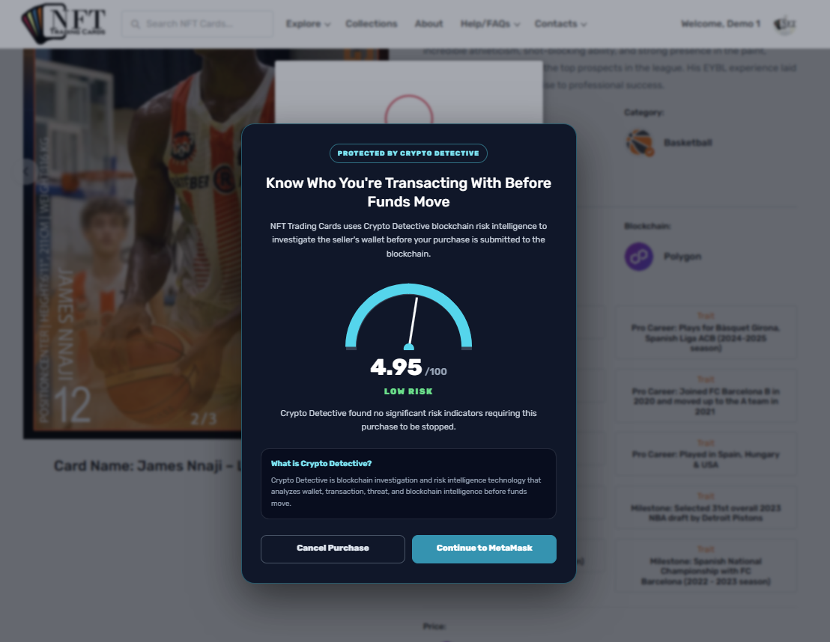
PRODUCTION INTEGRATION
Crypto Detective in Action — NFT Trading Cards
A real marketplace integration — risk intelligence before MetaMask.
HOW THE INTEGRATION WORKS
01 BUYER INITIATES PURCHASE
The marketplace identifies the seller wallet.
02 SERVER-SIDE INVESTIGATION
NFT Trading Cards calls the Crypto Detective REST API.
03 EXPLAINABLE RISK RESULT
Canonical score, risk level and hard-stop status returned.
04 BUYER PROTECTION
Buyer sees the risk gauge before MetaMask opens.
TESTED: Cancel stops before MetaMask; Continue opens MetaMask.
Crypto Detective supplies intelligence. The marketplace controls transaction policy.

Slide 11

COMPETITIVE LANDSCAPE
A Different Approach to Blockchain Risk Intelligence
◇
CHAINALYSIS / TRM LABS
CRYPTO
Enterprise compliance, monitoring & investigations
D E T E C T I V E
◯
ARKHAM INTELLIGENCE
Explainable risk intelligence at the point of decision
Entity attribution, analytics & risk intelligence
✓
Consumer-accessible investigations
▣
BLOCKAID
✓
Wallet + Contract + URL intelligence
Embedded transaction simulation & security
✓
Matrix V3 + proprietary Intelligence Library
✓
Threat intelligence + entity recognition
▤
BLOCK EXPLORERS / WALLETS
Blockchain visibility & transaction data
✓
Explainable 0–100 risk scoring
Turning multiple intelligence layers into an understandable decision before crypto moves.

Slide 12
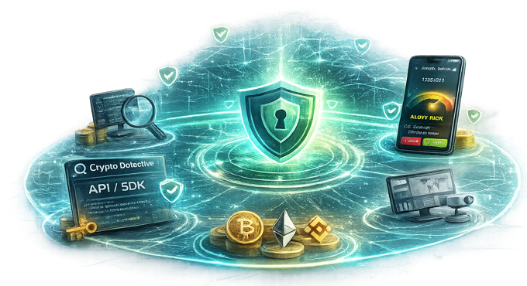
WHY WE WIN
Intelligence That Becomes More Valuable Over Time
DEFENSIBILITY LAYERS
THE INTELLIGENCE SYSTEM
01
PROPRIETARY INTELLIGENCE
Structured entity, protocol & risk intelligence
02
MATRIX V3 / R3
Multi-signal risk scoring architecture
03
THREAT INTELLIGENCE
Multiple independent threat sources
04
EXPLAINABLE RESULTS
Shows users why risk was identified
05
DEVELOPER DISTRIBUTION
Production API + published npm SDK
Intelligence • Scoring • Threats • Explainability • Distribution
The moat is the intelligence system behind the score.

Slide 13
ROADMAP
Platform + API + SDK Ready for Commercialization
✓
PHASE 1 — BUILD:
Core intelligence platform & Matrix V3
CURRENT POSITION
✓
V1.0, R3
PHASE 2 — LAUNCH:
Crypto Detective V1.0, R3 production release
LIVE PRODUCTION PLATFORM
3
PHASE 3 — EXPAND:
Ongoing chain & intelligence expansion
✓ BUILD ✓ LAUNCH
✓
PHASE 4 — INTEGRATE:
REST API, npm SDK & NFT integration complete
NEXT
5
PHASE 5 — SCALE:
Partnerships, enterprise & user growth
EXPAND → SELL → SCALE
API and SDK are built. Next: live billing validation and growth.

Slide 14
REVENUE MODEL & EARLY ECONOMICS
Recurring Revenue Built to Scale
01
CONSUMER SaaS
THE REVENUE ENGINE
Free → Paid subscription plans
Recurring monthly / annual revenue
INTELLIGENCE PLATFORM
02
API / SDK
↓
↓
↓
API 1K $99 • 5K $299 • 10K $499/mo
Published SDK + direct REST integration
CONSUMER
API / SDK
ENTERPRISE
Subscriptions
Licensing
Contracts
03
ENTERPRISE
Custom pricing for larger deployments
↓
Organization-specific volume and support
RECURRING REVENUE • SOFTWARE MARGINS • SCALE
One intelligence platform. Multiple revenue channels.

Slide 15
CRYPTO DETECTIVE
18-Month Path to Commercial Validation
Illustrative base-case planning scenario for the $200K pre-seed raise
01
02
03
04
~244
5
~$8.7K
~$104K
PAID CONSUMER
CUSTOMERS
ENTERPRISE / API
CUSTOMERS
MONTHLY RECURRING
REVENUE
ARR RUN RATE AT
MONTH 18
CAPITAL EFFICIENCY
$200K pre-seed capital is designed to fund 18 months of commercialization while preserving operating flexibility.
Base case: 750 → 6,000 monthly visitors • 7.5% visitor-to-registration • 8% registration-to-paid • 4% monthly churn • ~$15 consumer ARPA
.

Slide 16
THE ASK
Raising $200K Pre-Seed
Platform, API and SDK built. Capital accelerates commercialization.
USE OF FUNDS
CAPITAL → GROWTH
01
CUSTOMER ACQUISITION
Build awareness and grow the user base
$200K
INTELLIGENCE EXPANSION
PRE-SEED
02
Expand coverage, chains and threat intelligence
API CUSTOMER GROWTH
SCALE
03
ACQUIRE
Operations
INTEGRATE
Acquire API customers and integration partners
Users
Platforms
OPERATIONS & SCALE
EXPAND
04
Intelligence
Infrastructure, security and commercialization
Fund the transition from product launch to market expansion.
The product is built. Now we scale it.

Slide 17
THE PRODUCT IS LIVE.
The Next Chapter Is Growth.
LIVE PLATFORM
https://cryptodetective.app
Raising $200K Pre-Seed
Steve Steinberger
Founder & CTO
Crypto Detective Labs, Inc.
steve@cryptodetective.app
+1 (561) 281-8330
KNOW BEFORE YOU SEND
Explainable blockchain risk intelligence
before crypto moves.
V1.0, R3 — LIVE PRODUCTION PLATFORM
Know Before You Send.

